Slide 1
Vectors

Slide 2
VECTORS

Slide 3
A VECTOR?
Describes the motion of an object
A Vector comprises
  Direction
  Magnitude
We will consider
  Column Vectors
  General Vectors
  Vector Geometry
Size

Slide 4
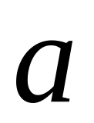
Scalars and Vectors
A scalar is a single number that represents a magnitude
  E.g. distance, mass, speed, temperature, etc.
A vector is a set of numbers that describe both a magnitude and direction
  E.g. velocity (the magnitude of velocity is speed), force, momentum, etc.
Notation: a vector-valued variable is differentiated from a scalar one by using bold or the following symbol:
A

Slide 5
Characteristics of Vectors
A Vector is something that has two and only two defining characteristics:
Magnitude: the 'size' or 'quantity'
Direction: the vector is directed from one place to another.

Slide 6
Direction
Speed vs. Velocity
Speed is a scalar, (magnitude no direction) - such as 5 feet per second.
Speed does not tell the direction the object is moving. All that we know from the speed is the magnitude of the movement.
Velocity, is a vector (both magnitude and direction) – such as 5 ft/s Eastward. It tells you the magnitude of the movement, 5 ft/s, as well as the direction which is Eastward.

Slide 7
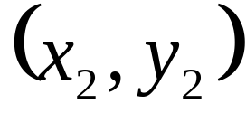
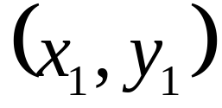
How can we find the magnitude if we have the initial point and the terminal point?
Q
The distance formula
Terminal Point
magnitude is the length
direction is
this angle
Initial Point
P
How can we find the direction? (Is this all looking familiar for each application? You can make a right triangle and use trig to get the angle!)

Slide 8
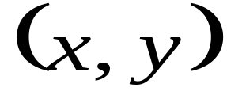
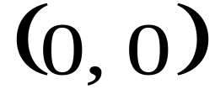
Although it is possible to do this for any initial and terminal points, since vectors are equal as long as the direction and magnitude are the same, it is easiest to find a vector with initial point at the origin and terminal point (x, y).
Q
Terminal Point
A vector whose initial point is the origin is called a position vector
direction is
this angle
Initial Point
P
If we subtract the initial point from the terminal point, we will have an equivalent vector with initial point at the origin.

Slide 9
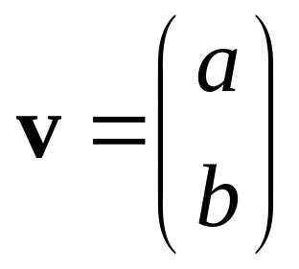
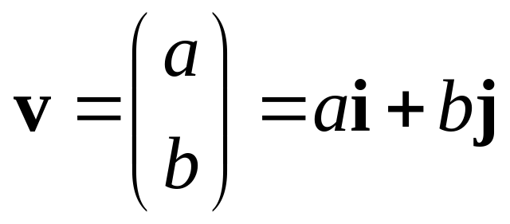


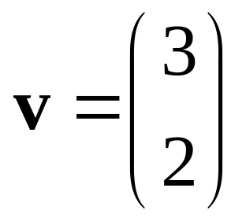
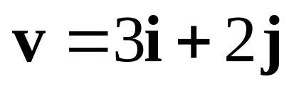
This is the notation for a position vector. This means the point (a, b) is the terminal point and the initial point is the origin.
Vectors are denoted with bold letters
We use vectors that are only 1 unit long to build position vectors. i is a vector 1 unit long in the x direction and j is a vector 1 unit long in the y direction.
(a, b)
(3, 2)

Slide 10
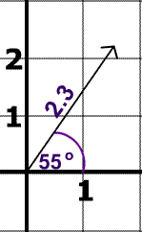
Example
The direction of the vector is 55° North of East
The magnitude of the vector is 2.3.

Slide 11
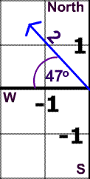
Now You Try
Direction:
Magnitude:
47° North of West
2

Slide 12
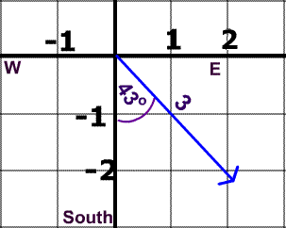
Try Again
Direction:
Magnitude:
43° East of South
3

Slide 13
Try Again
It is also possible to describe this vector's direction as 47 South of East.
Why?

Slide 14
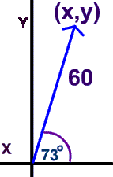
Expressing Vectors as Ordered Pairs
How can we express this vector as an ordered pair?
Use Trigonometry

Slide 15
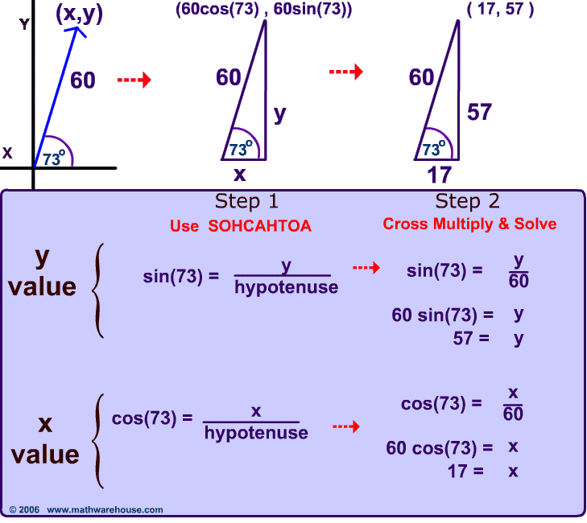

Slide 16
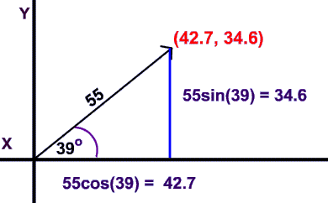
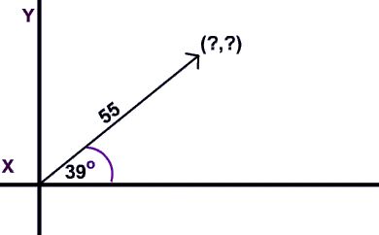
Now You Try
Express this vector as an ordered pair.

Slide 17
This is the notation for a position vector. This means the point (a, b) is the terminal point and the initial point is the origin.
Vectors are denoted with bold letters
We use vectors that are only 1 unit long to build position vectors. i is a vector 1 unit long in the x direction and j is a vector 1 unit long in the y direction.
(a, b)
(3, 2)

Slide 18
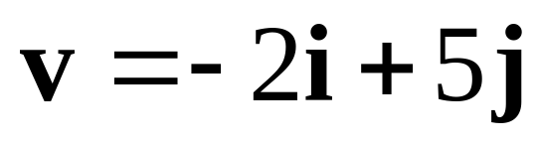
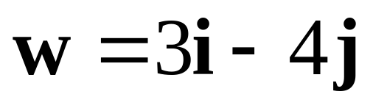
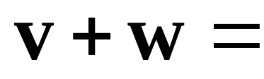
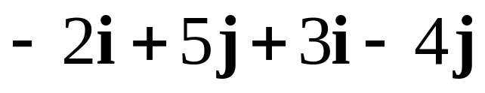
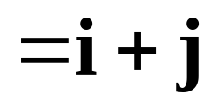

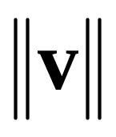
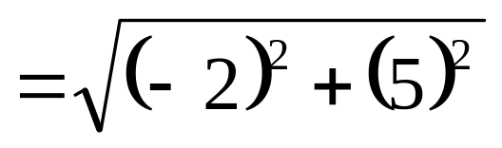



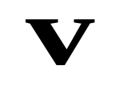

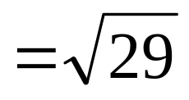


If we want to add vectors that are in the form ai + bj, we can just add the i components and then the j components.
When we want to know the magnitude of the vector (remember this is the length) we denote it
Let's look at this geometrically:
Can you see from this picture how to find the length of v?

Slide 19
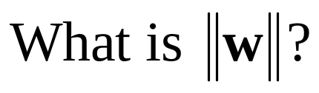
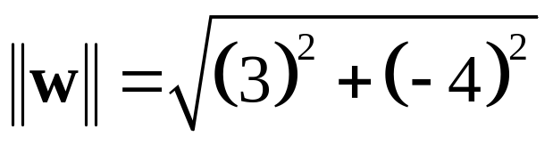
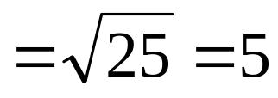
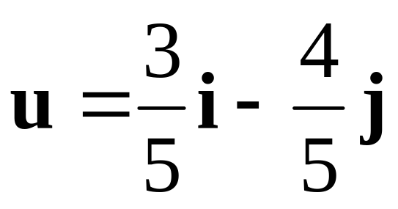
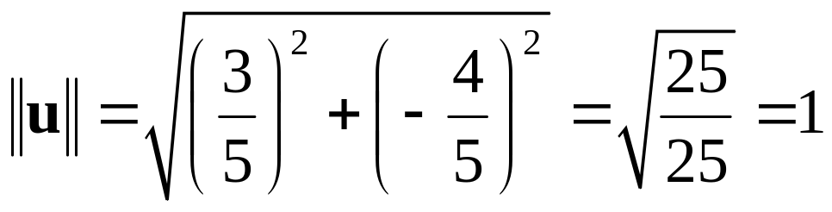
A unit vector is a vector with magnitude 1.
If we want to find the unit vector having the same direction as a given vector, we find the magnitude of the vector and divide the vector by that value.
If we want to find unit vector having the same direction as w we need to divide w by 5. the u
Let's check this to see if it really is 1 unit long.

Slide 20
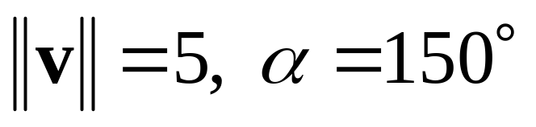


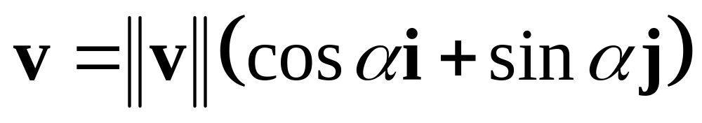
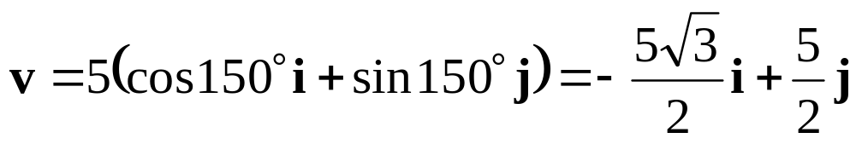
If we know the magnitude and direction of the vector, let's see if we can express the vector in ai + bj form.
As usual we can use the trig we know to find the length in the horizontal direction and in the vertical direction.

Slide 21
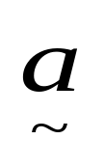
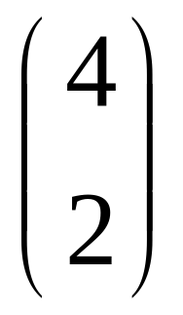
Column Vectors
NOTE!
Label is in BOLD.
When handwritten,
draw a wavy line
under the label
i.e.
Vector a
a
2 up
4 RIGHT
COLUMN Vector

Slide 22
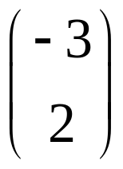
Column Vectors
Vector b
2 up
b
3 LEFT
COLUMN Vector?

Slide 23
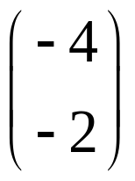
Column Vectors
Vector u
n
2 down
4 LEFT
COLUMN Vector?

Slide 24
Column Vectors
Vector u
n
2 down
4 LEFT
COLUMN Vector?

Slide 25
Column Vectors
Vector u
n
2 down
4 LEFT
COLUMN Vector?

Slide 26
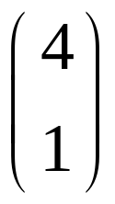
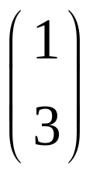
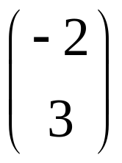
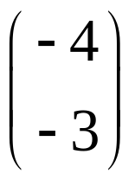
Describe these vectors
c
b
a
d

Slide 27
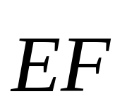
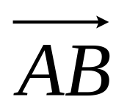
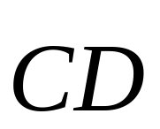
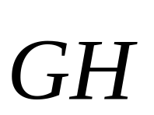
Alternative labelling
B
F
D
E
G
A
C
H

Slide 28
General Vectors
A Vector has BOTH a Length & a Direction
All 4 Vectors here are EQUAL in Length and
Travel in SAME Direction.
All called k
k
k
k
k
k can be in any position

Slide 32
A vector is a quantity that has both magnitude and direction. It is represented by an arrow. The length of the vector represents the magnitude and the arrow indicates the direction of the vector.
Blue and orange vectors have same magnitude but different direction.
Blue and purple vectors have same magnitude and direction so they are equal.
Blue and green vectors have same direction but different magnitude.
Two vectors are equal if they have the same direction and magnitude (length).

Slide 33
General Vectors
B
Line CD is Parallel to AB
CD is TWICE length of AB
k
A
D
2k
Line EF is Parallel to AB
E
C
EF is equal in length to AB
-k
EF is opposite direction to AB
F

Slide 34
Write these Vectors in terms of k
k
B
D
2k
F
G
1½k
½k
E
A
C
-2k
H

Slide 35
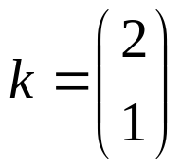
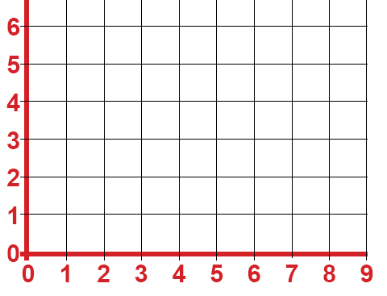


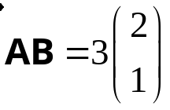
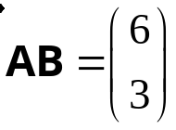

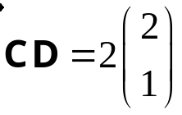

Combining Column Vectors
B
k
D
A
C

Slide 36


To add vectors, we put the initial point of the second vector on the terminal point of the first vector. The resultant vector has an initial point at the initial point of the first vector and a terminal point at the terminal point of the second vector (see below--better shown than put in words).
To add vectors, we put the initial point of the second vector on the terminal point of the first vector. The resultant vector has an initial point at the initial point of the first vector and a terminal point at the terminal point of the second vector (see below--better shown than put in words).
To add vectors, we put the initial point of the second vector on the terminal point of the first vector. The resultant vector has an initial point at the initial point of the first vector and a terminal point at the terminal point of the second vector (see below--better shown than put in words).
Terminal point of w
Move w over keeping the magnitude and direction the same.
Initial point of v

Slide 37




Adding Vectors
Add vectors A and B

Slide 38
Adding Vectors
On a graph, add vectors using the “head-to-tail” rule:
Move B so that the head of A touches the tail of B
Note: “moving” B does not change it. A vector is only defined by its magnitude and direction, not starting location.

Slide 39


Adding Vectors
The vector starting at the tail of A and ending at the head of B is C, the sum (or resultant) of A and B.

Slide 40








Using the vectors shown, find the following:

Slide 41




Simple combinations
C
B
A

Slide 42









Vector Geometry
Consider this parallelogram
Q
P
a
R
Opposite sides are Parallel
b
O
OQ is known as the resultant of a and b

Slide 43
Resultant of Two Vectors
Is the same, no matter which route is followed
Use this to find vectors in geometrical figures

Slide 44


Example
S is the Midpoint of PQ.
Work out the vector
.
Q
S
P
a
R
= a + ½b
b
O

Slide 45

Alternatively
S is the Midpoint of PQ.
Work out the vector
.
Q
S
P
a
R
= b
+ a
- ½b
b
O
= ½b + a
= a + ½b

Slide 46
Example
C
AC= p, AB = q
p
M
M is the Midpoint of BC
A
q
B
Find BC
BC
=
BA
+
AC
= -q + p
= p - q

Slide 47
Example
C
AC= p, AB = q
p
M
M is the Midpoint of BC
A
q
B
Find BM
BM
=
½BC
= ½(p – q)

Slide 48
Example
C
AC= p, AB = q
p
M
M is the Midpoint of BC
A
q
B
Find AM
AM
=
AB
+ ½BC
= q + ½(p – q)
= q +½p - ½q
= ½q +½p
= ½(q + p)
= ½(p + q)

Slide 49
Alternatively
C
AC= p, AB = q
p
M
M is the Midpoint of BC
A
q
B
Find AM
AM
=
AC
+ ½CB
= p + ½(q – p)
= p +½q - ½p
= ½p +½q
= ½(p + q)

Slide 50
Simple combinations
C
B
A

Slide 51

Adding Vectors
Note: moving a vector does not change it. A vector is only defined by its magnitude and direction, not starting location

Slide 52


Adding Vectors
Let’s go back to our example:
Now our vectors have values.

Slide 53
Adding Vectors
What is the value of our resultant?
GeoGebra Investigation

